Slide 1
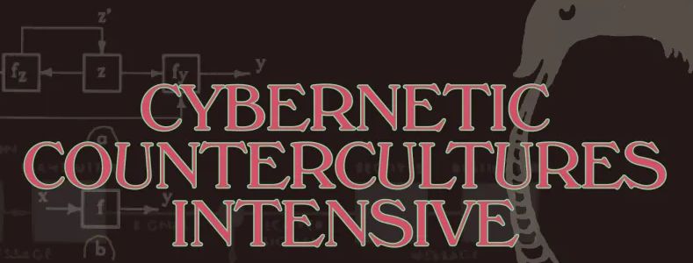
Week 1. Introduction:
The Whole Earth Network, Organic Cybernetics, and the Problem with Intelligence

Slide 2
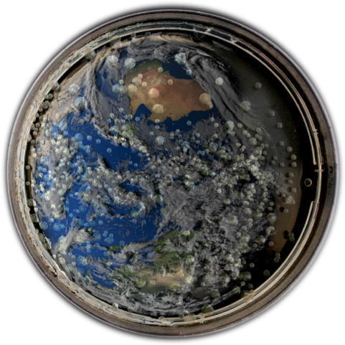
The Whole Earth Network and Organic Cybernetics
Part One

Slide 3
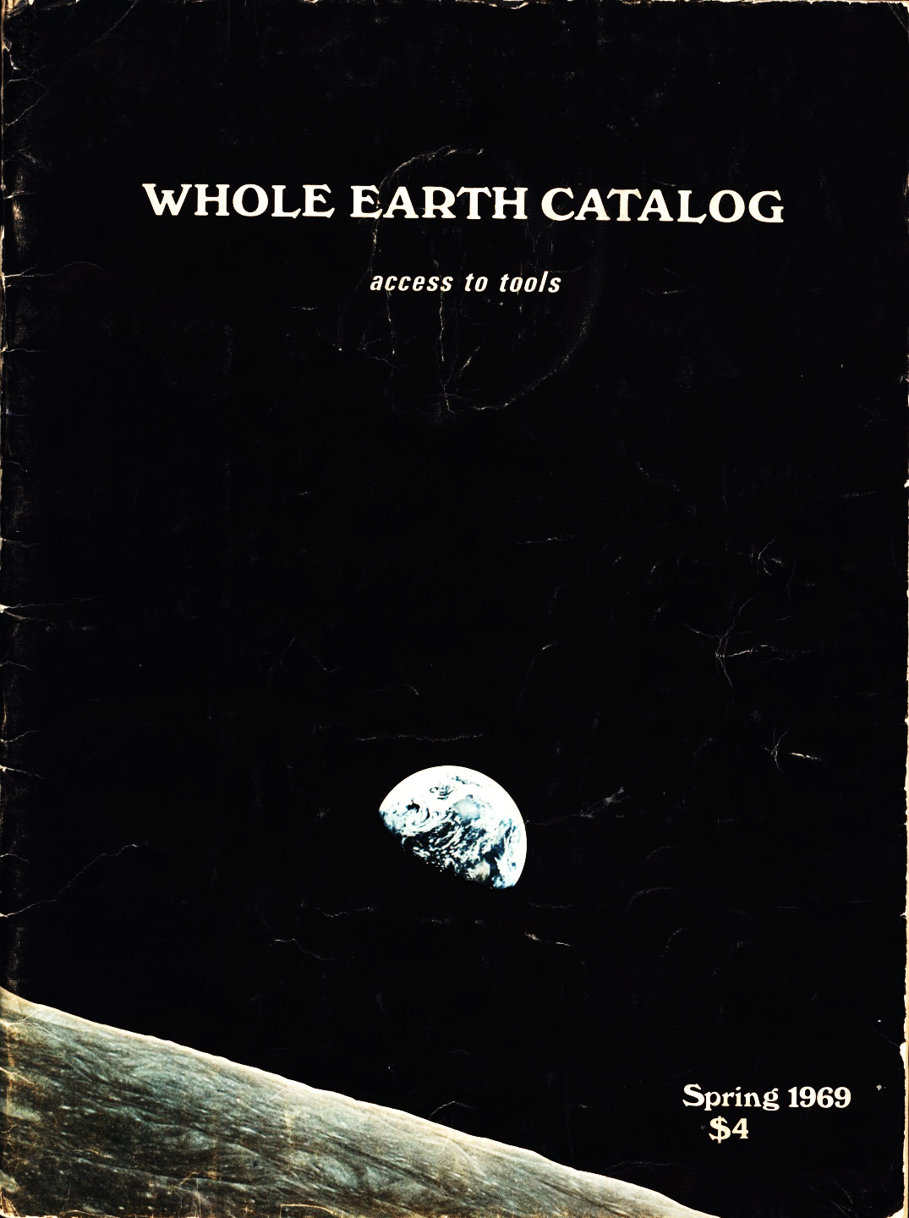
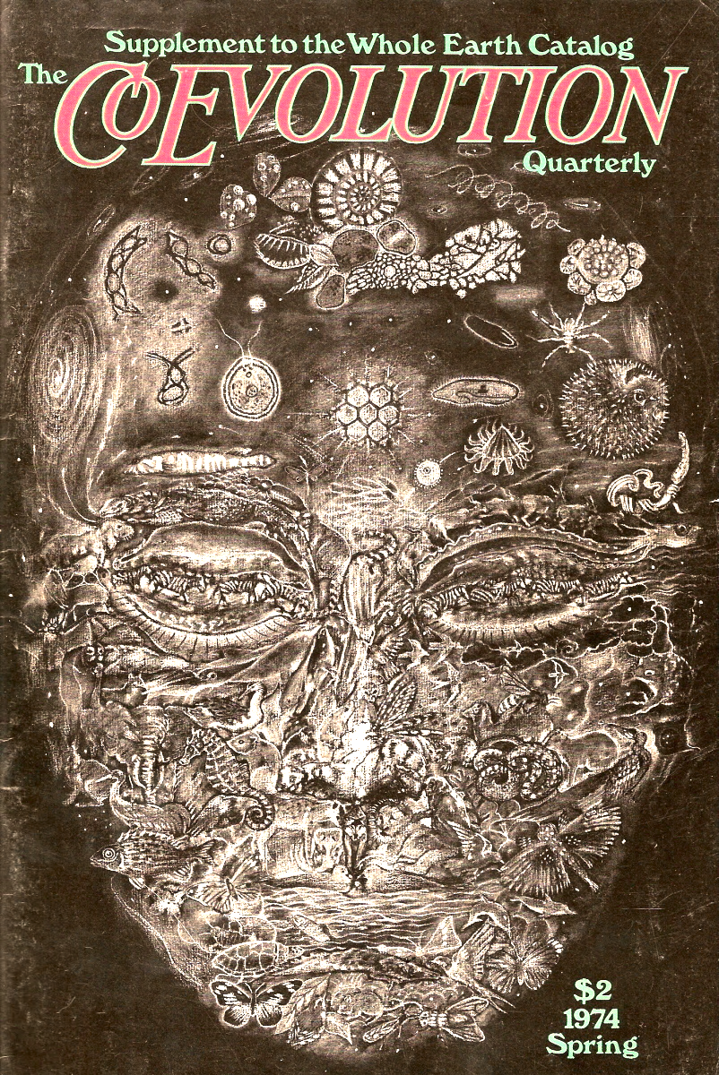
/

Slide 4
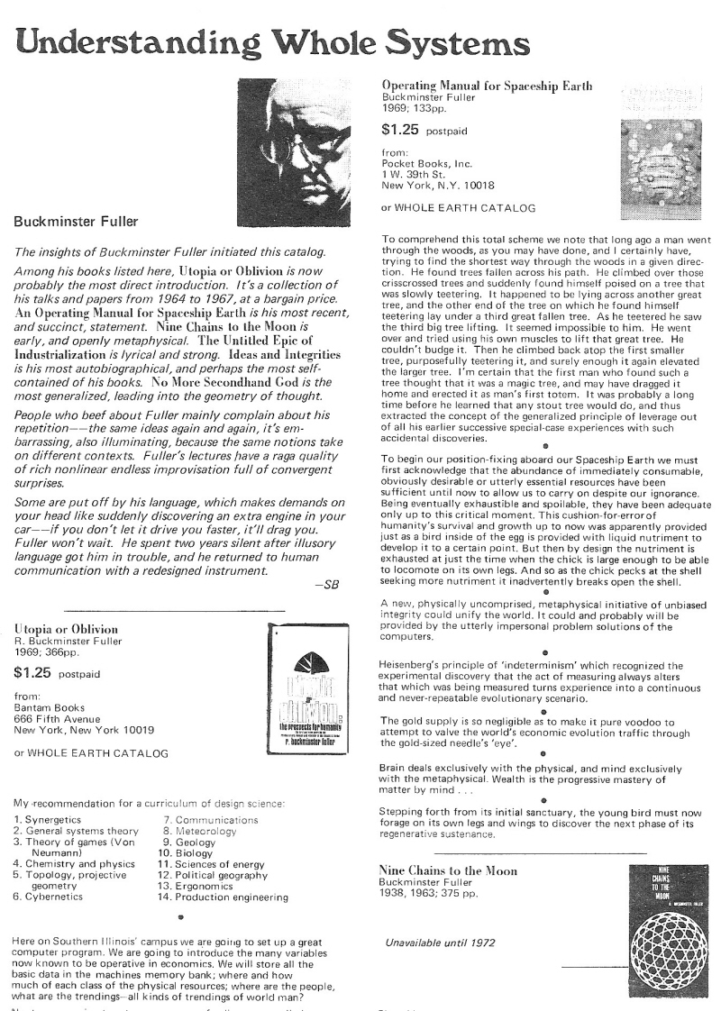
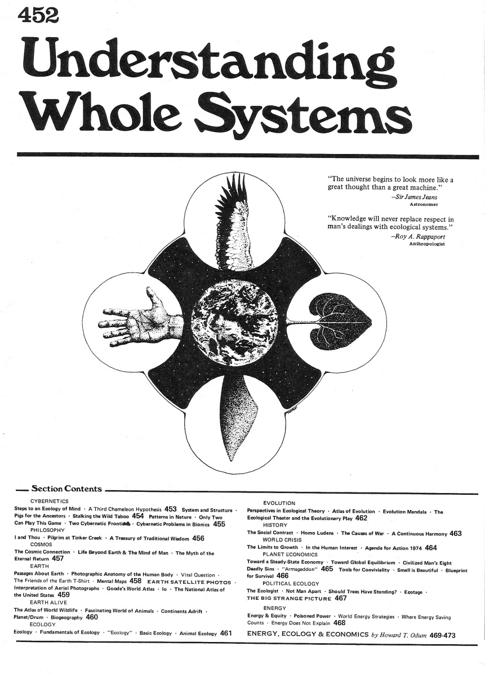

Slide 5
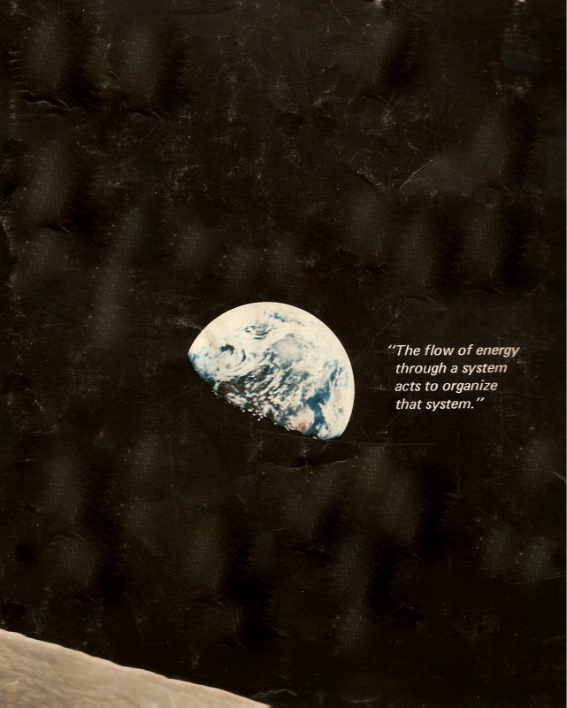
Whole Earth Catalog (Spring 1969), outside back cover (detail): “The flow of energy through a system acts to organize that system.”
Harold Morowitz, Energy Flow in Biology (1968):“The purpose of this book is to discuss and present evidence for the general thesis that the flow of energy through a system acts to organize that system. The motivation for this approach is biological and has its origins in an attempt to find a physical rationale for the extremely high degree of molecular order encountered in living systems.”

Slide 6
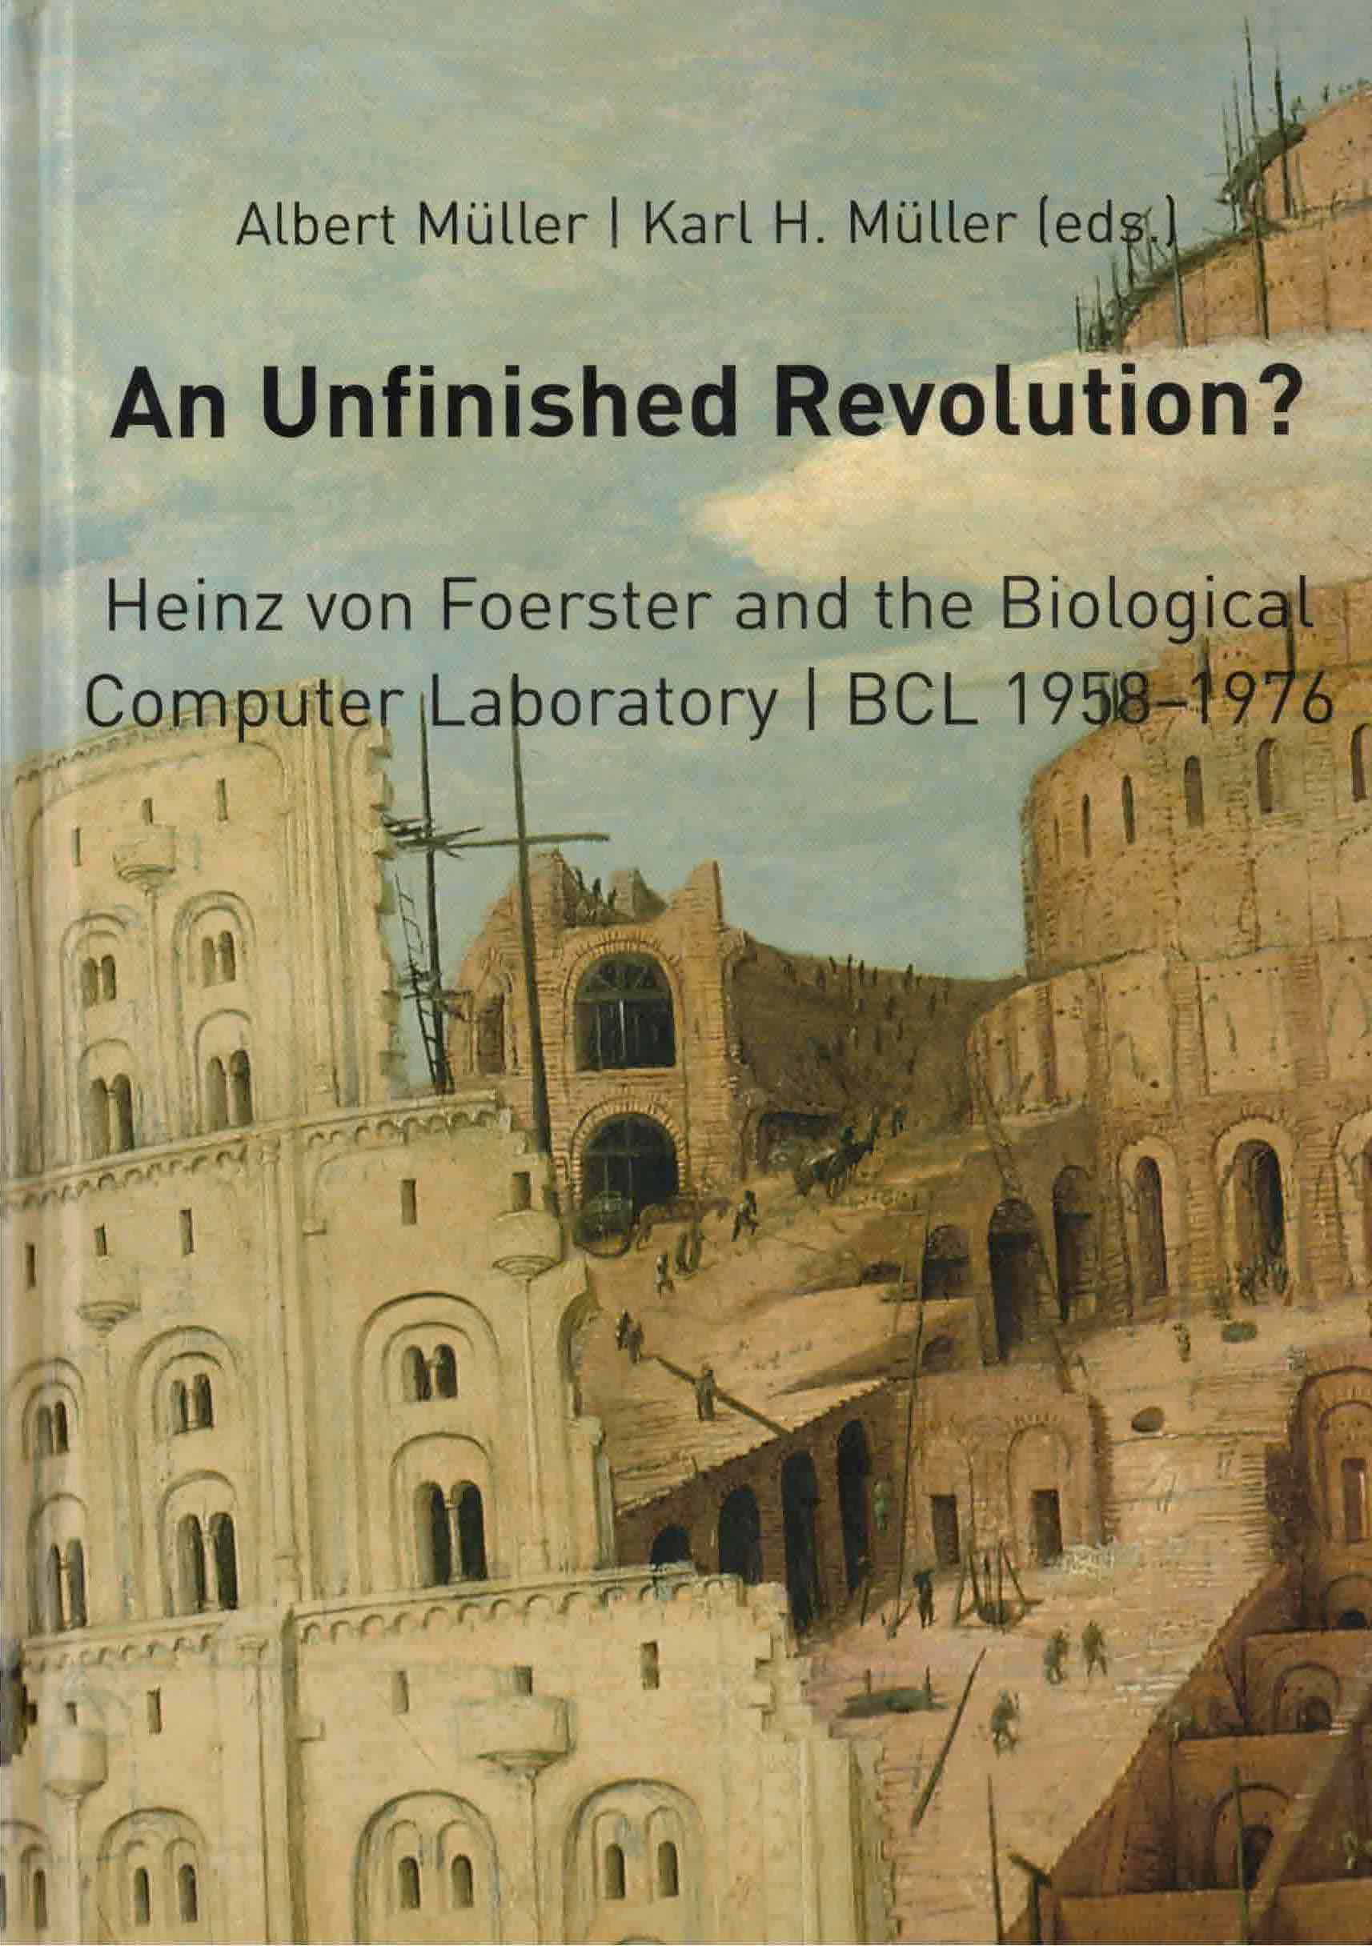

Slide 8
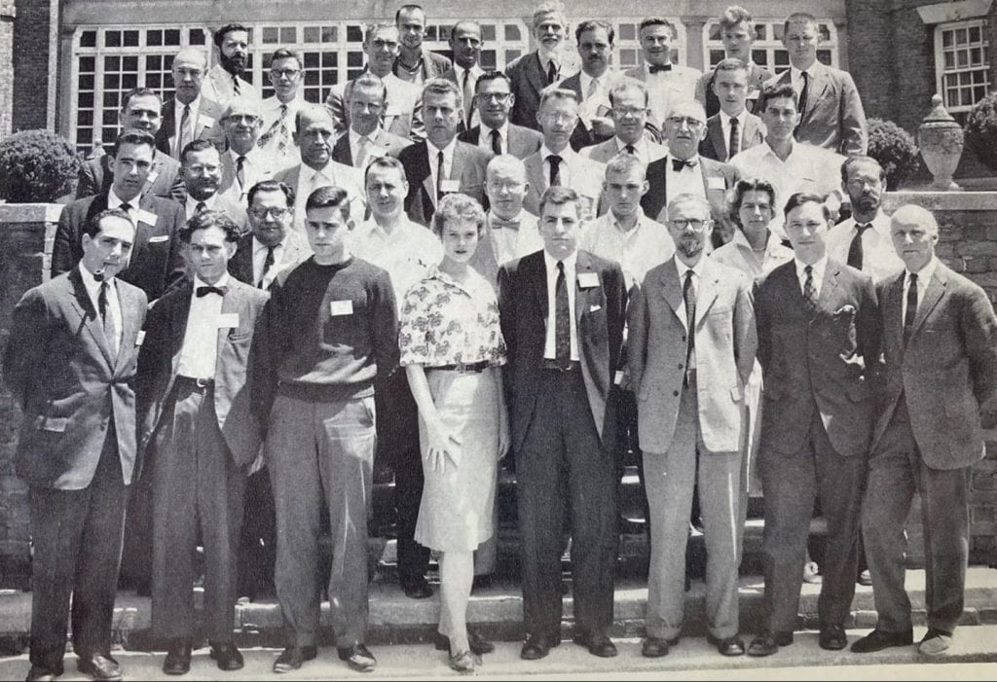
A decade before the Cybernetic Countercultures
Von Foerster
Cybernetic notables in attendance:
Warren McCulloch,
Ross Ashby,
Stafford Beer, Ludwig von Bertalanffy, Gordon Pask, Anatol Rapaport.
Through the Biological Computer Laboratory Heinz von Foerster organized a key conference in the development of cybernetics. In many ways a continuation of the Macy Conferences, the Symposium on Principles of Self-Organization was held at the University of Illinois at Urbana-Champaign on June 8–9, 1960. (Wikipedia)

Slide 9
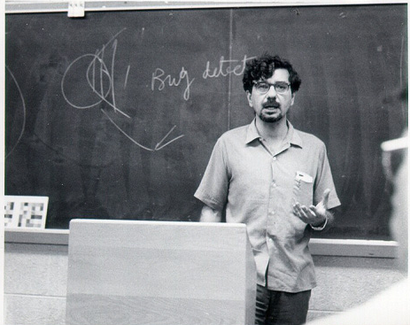
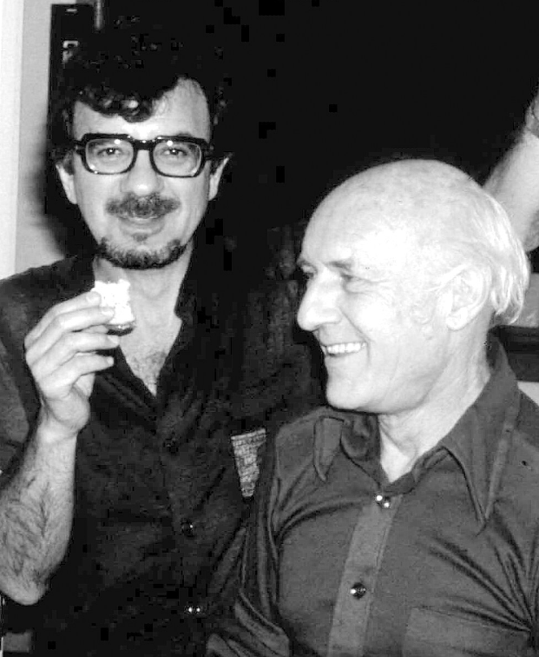
Humberto Maturana in Jerry Lettvin’s lab, @ 1959
Maturana and von Foerster at the Biological Computer Lab, 1974

Slide 10
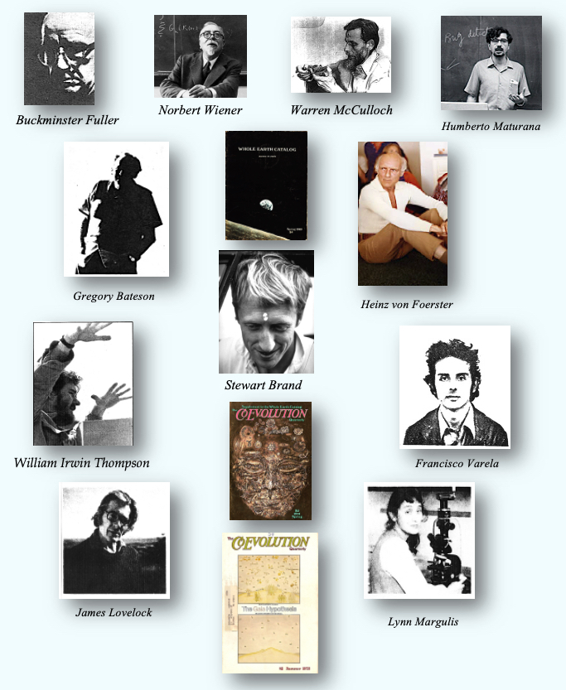
The
Cybernetic Countercultures network

Slide 12
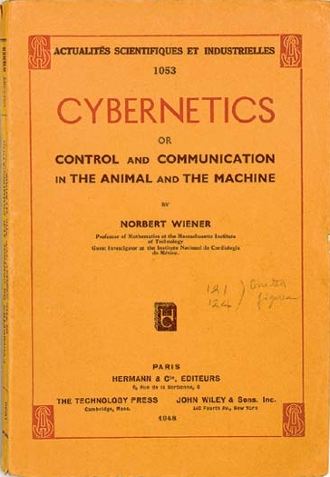
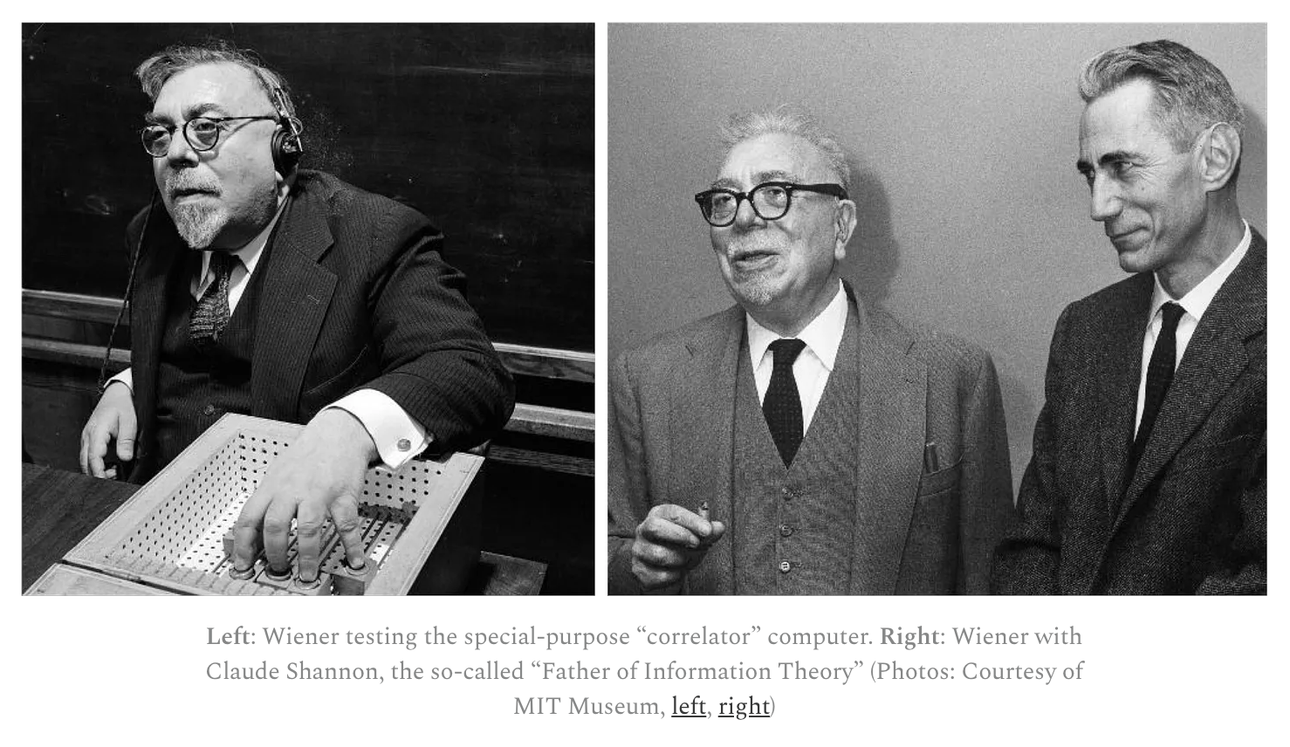
Source: https://www.privatdozent.co/p/the-absent-minded-father-of-cybernetics-db9

Slide 13
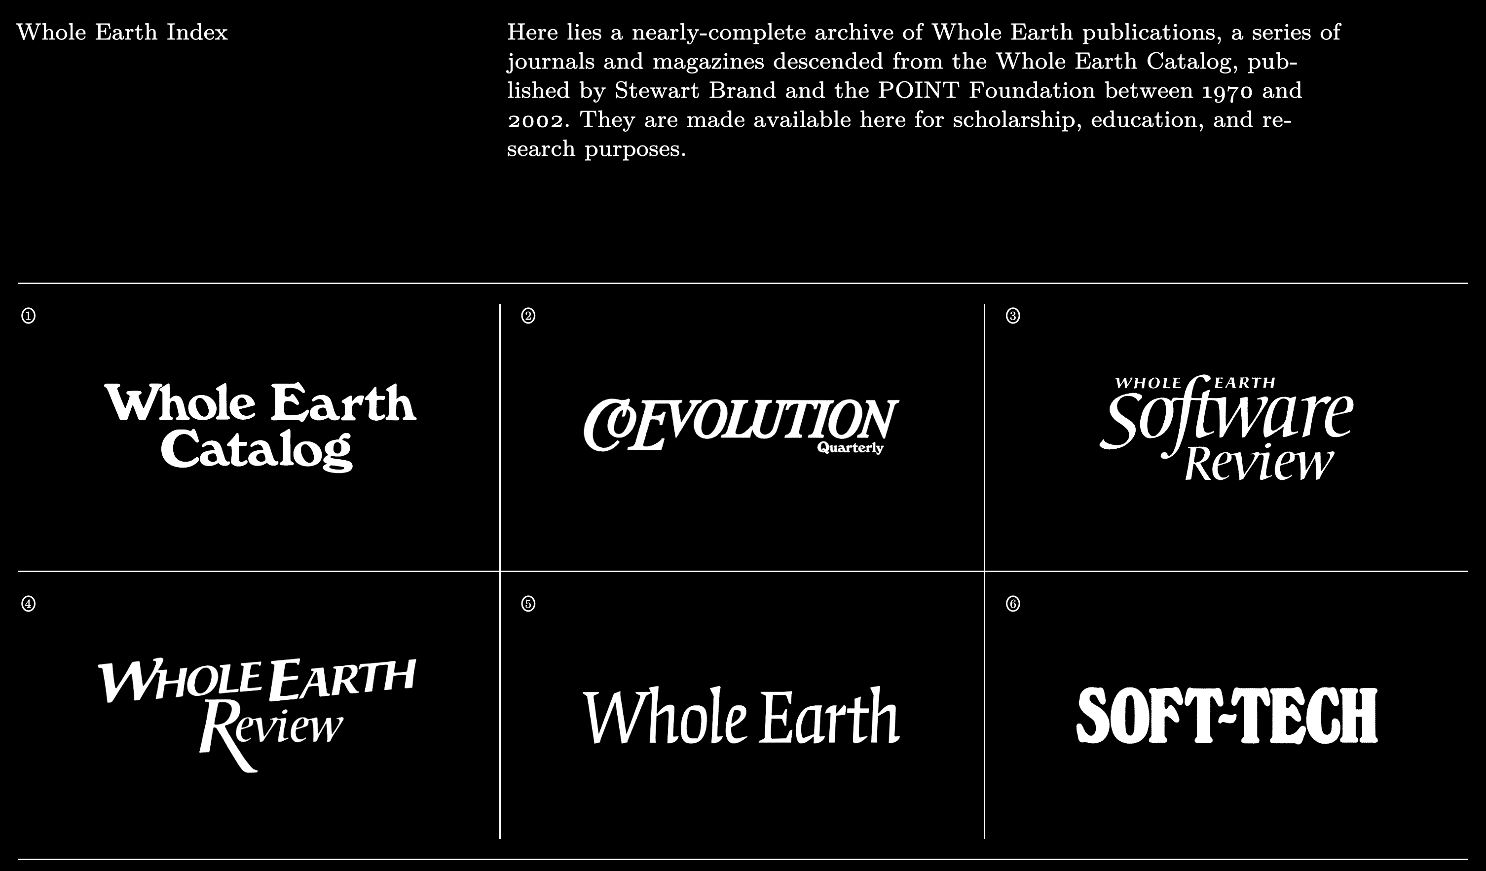
https://wholeearth.info/

Slide 14
The
Cybernetic Countercultures network

Slide 17
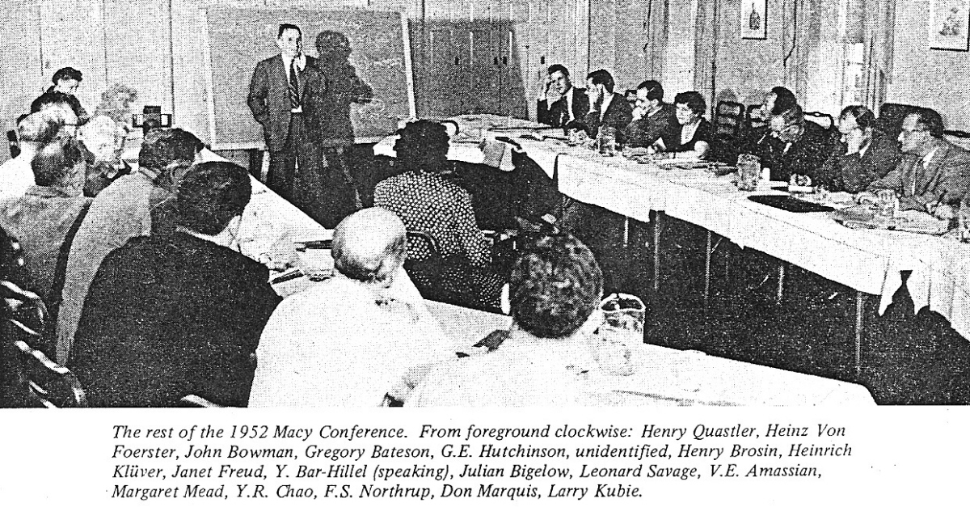
Bateson
Mead
von Foerster
Source: CoEvolution Quarterly 10 (Summer 1976): 35

Slide 18
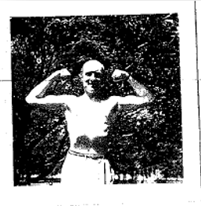

Slide 19
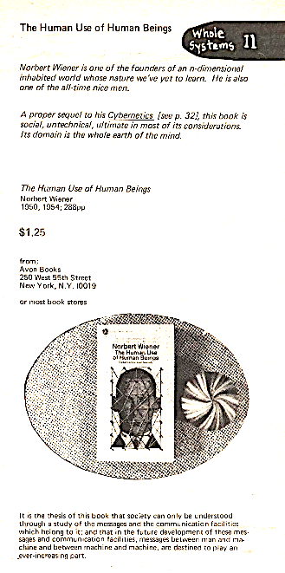
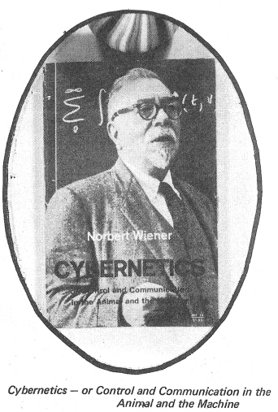
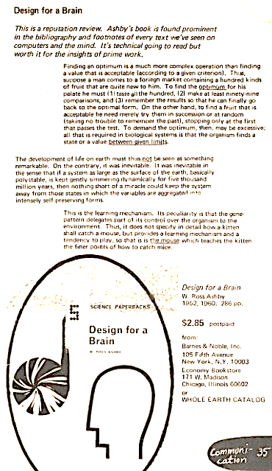
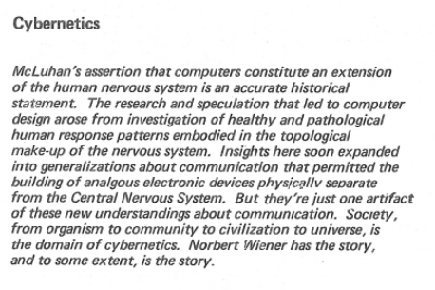
—from the first Whole Earth Catalog (Fall 1968)

Slide 20
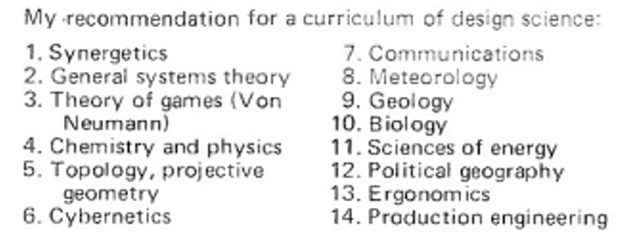
Stewart Brand, editor, Last Whole Earth Catalog (1971): 3.
The insights of Buckminster Fuller initiated this catalog.

Slide 21
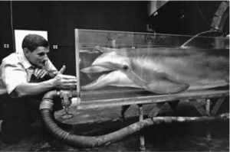
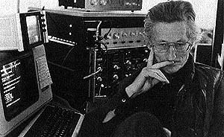
John Lilly

Slide 22
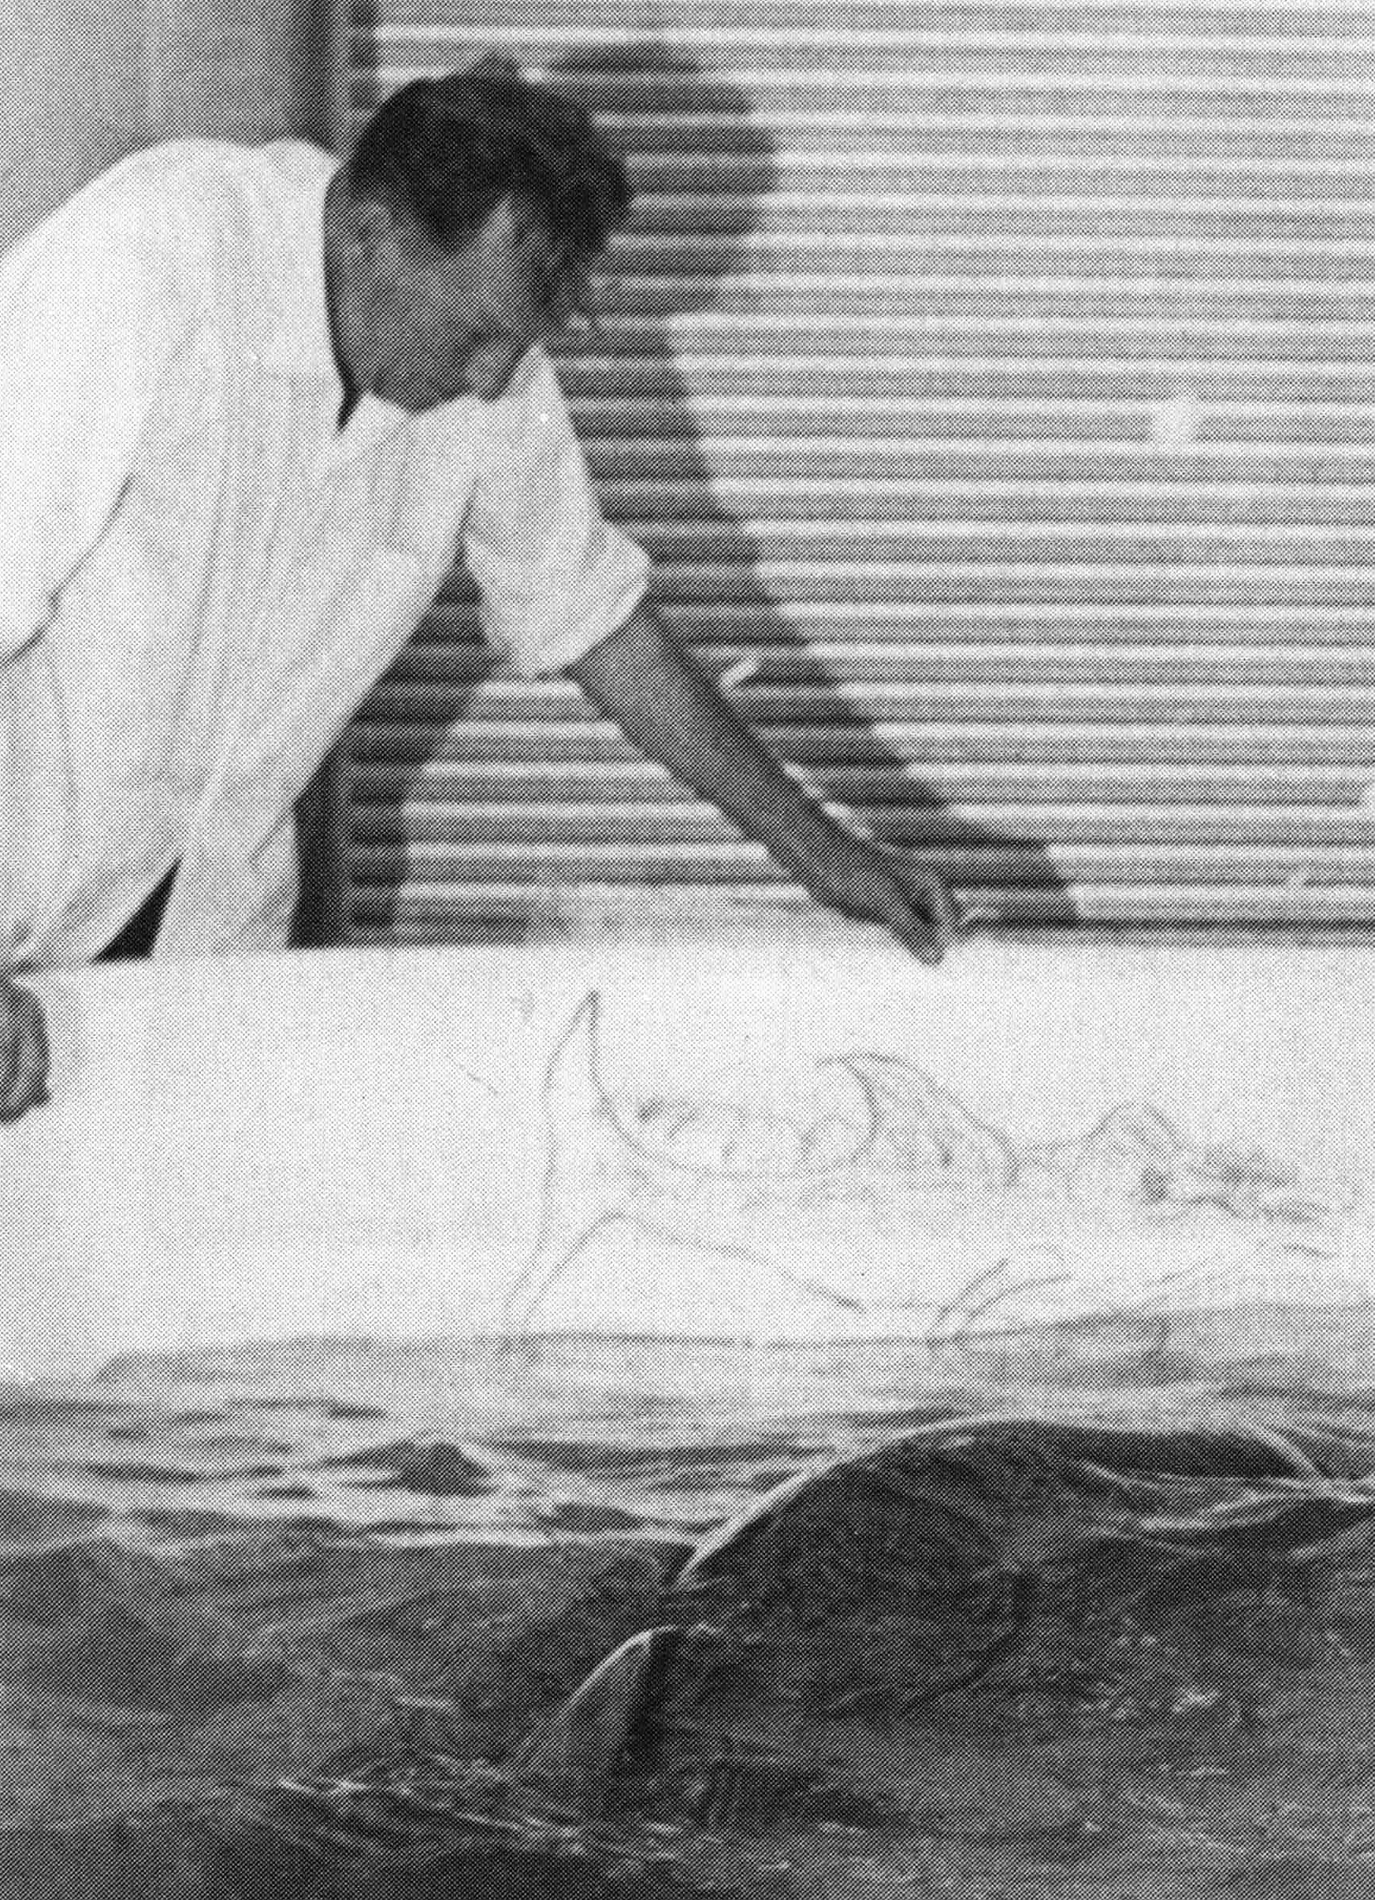
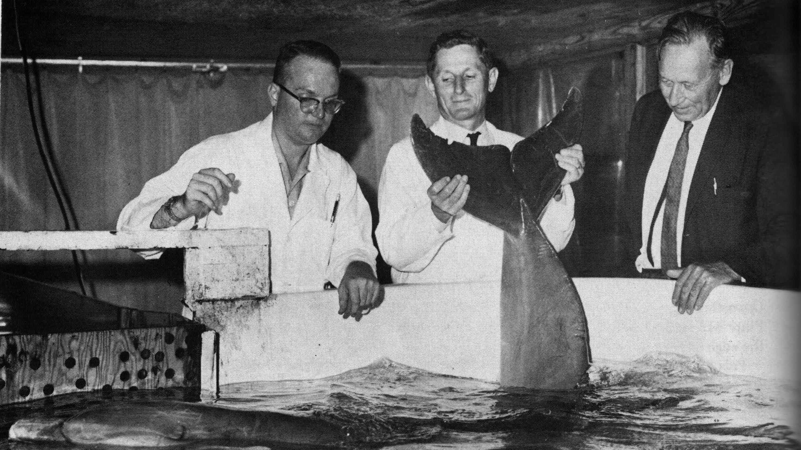
--Gregory Bateson at John Lilly’s dolphin lab in St. Thomas, 1963, 1964. Photographs from John C. Lilly, M.D., Communication between Man and Dolphin: The Possibilities of Talking with Other Species (Crown, 1978).

Slide 23
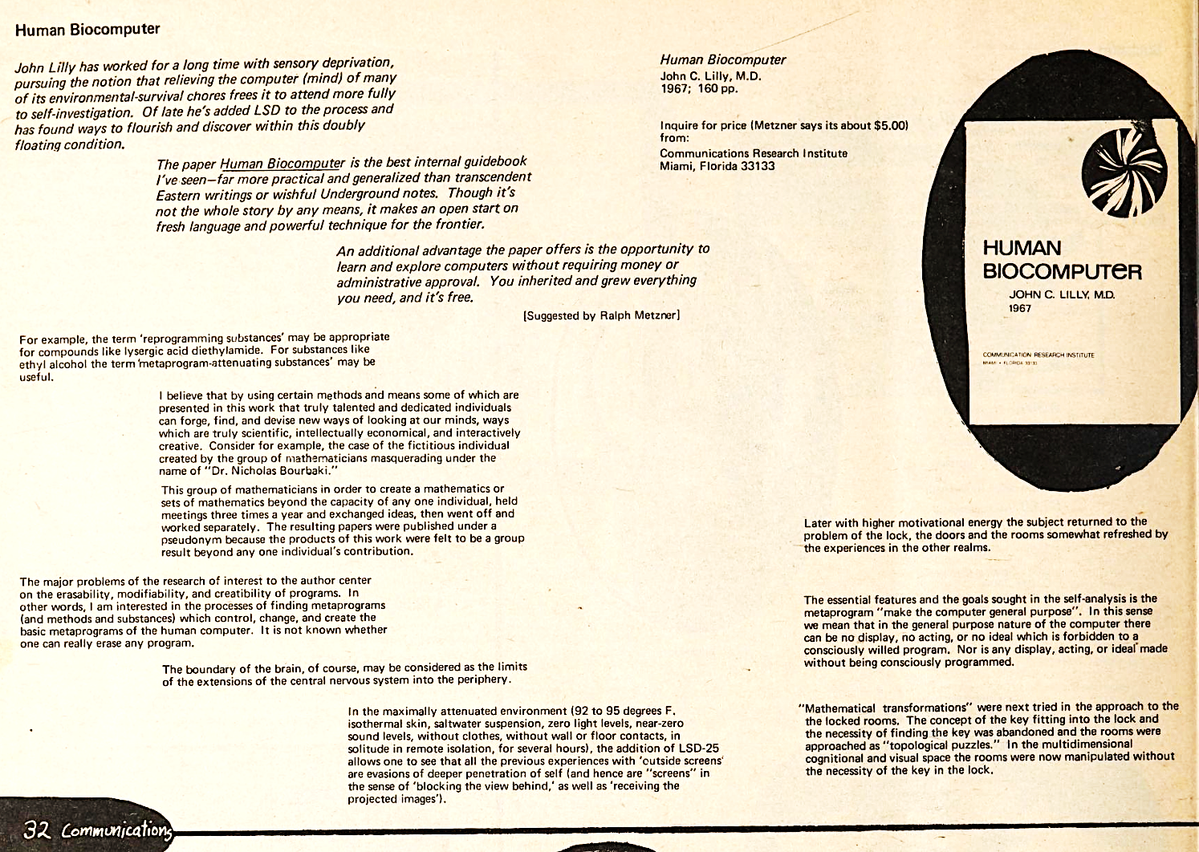
Whole Earth Catalog (Fall 1968)

Slide 24
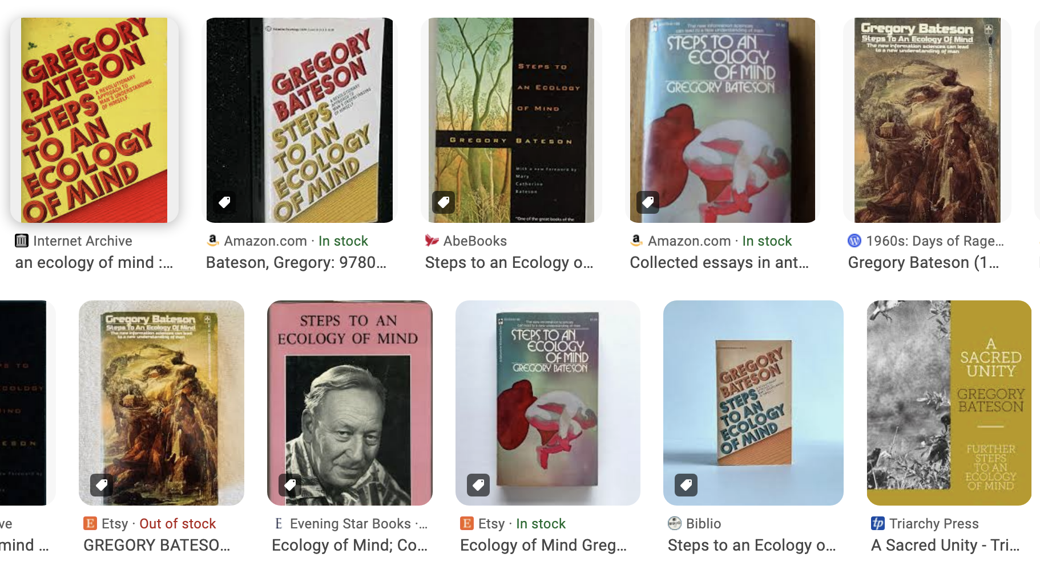

Slide 25
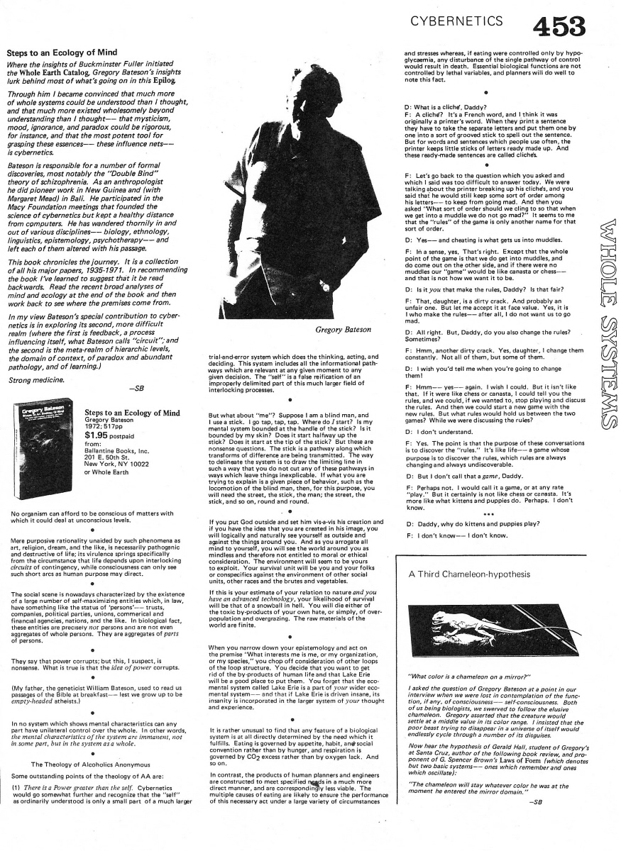
I became convinced that much more of whole systems could be understood than I thought, and that much more existed wholesomely beyond understanding than I thought—that mysticism, mood, ignorance, and paradox could be rigorous, for instance, and that the most potent tool for grasping these essences—these influence nets—is cybernetics. . . . —SB
Stewart Brand, editor,
Whole Earth Epilog (September 1974).

Slide 26
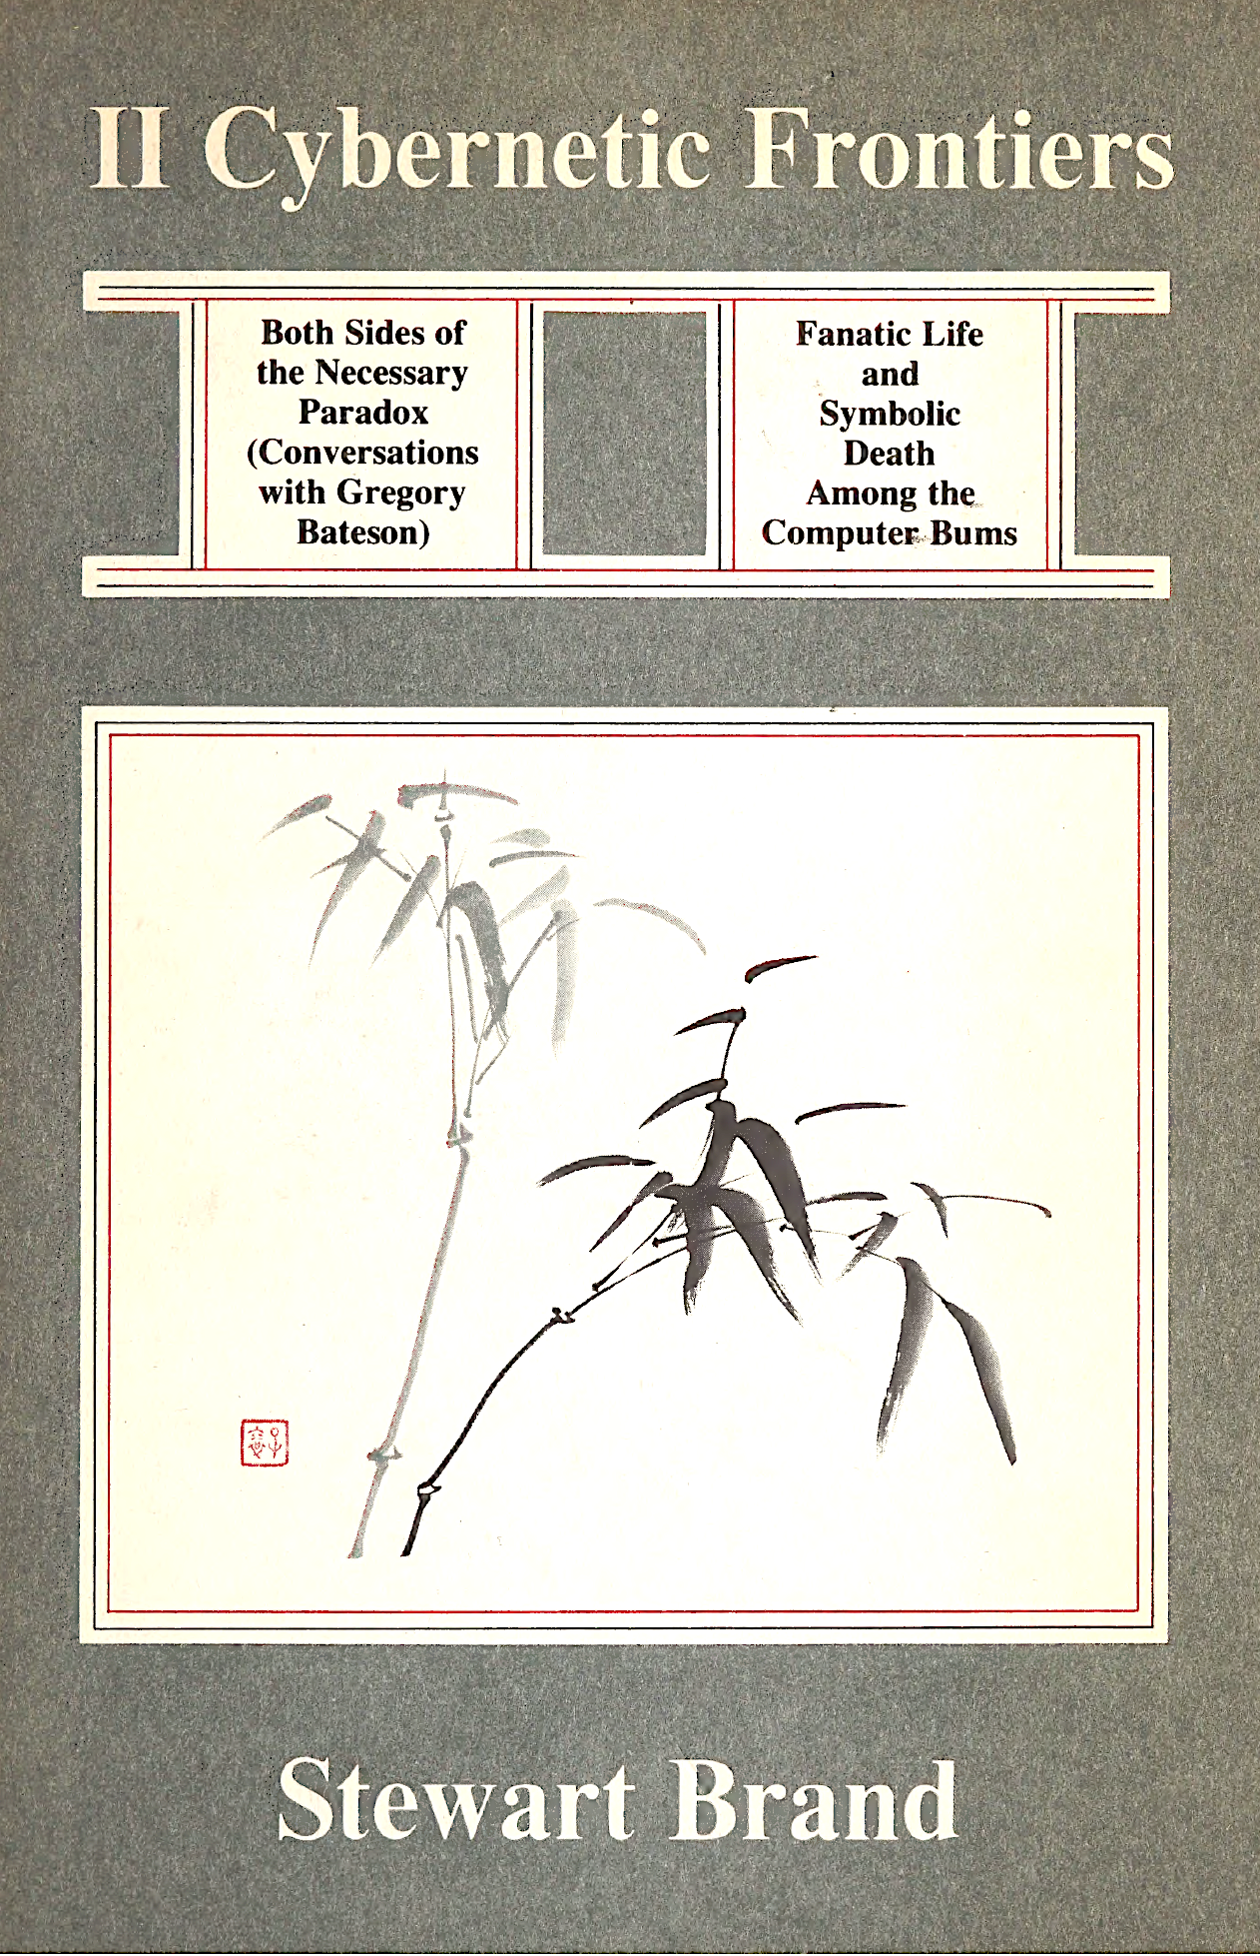
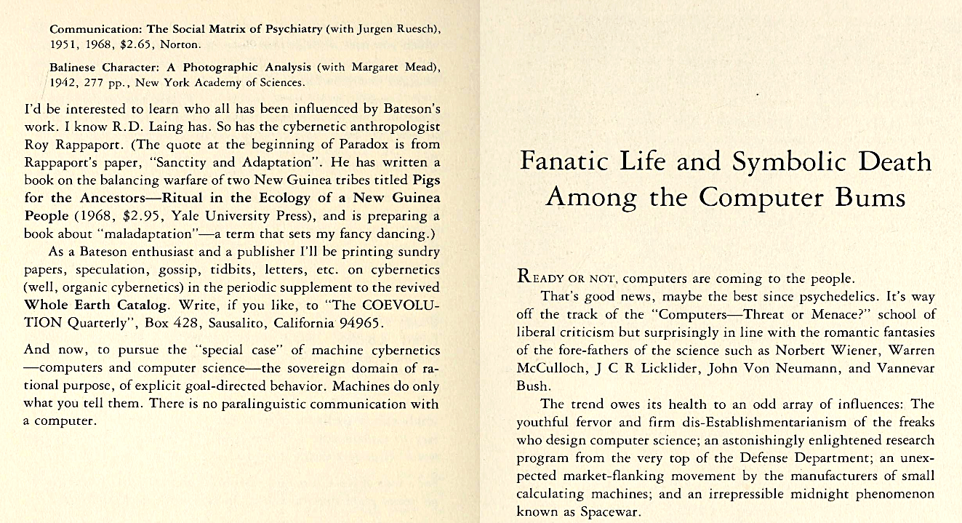
As a Bateson enthusiast and a publisher I’ll be printing sundry papers, speculation, gossip, tidbits, letters, etc. on cybernetics (well, organic cybernetics), in the periodic supplement to the revived Whole Earth Catalog . . . .

Slide 27
Humberto Maturana in Jerry Lettvin’s lab, @ 1959
Maturana and von Foerster at the Biological Computer Lab, 1974

Slide 28
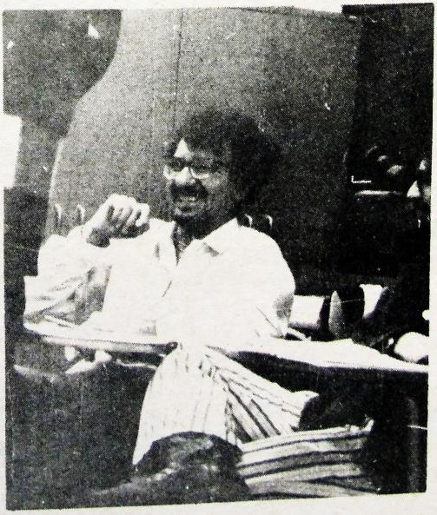
“What I think that Heinz may say is, that I came in a moment to the BCL in which my way of facing the questions about cognition in the domain of biology made a difference: introducing the observer as an active participant in the generation of understanding and in the process of explaining the observer. That was my concern: explaining the observer, not merely claiming, the observer is there, but explaining it. . . .”
“When I came back in 1968 for a longer time . . . I put my emphasis on circularity, on the observer participating, on the distinction by an observer. . . . [Von Foerster] was still speaking in those days about information and information in the envi­ronment. I remember that during one of my first lectures in Illinois I said: ‘Information does not exist, it is a useless notion in biology… because biological systems do not operate in these terms, it is a useful notion for design for understanding sys­tems that are very well specified, you may describe relations in these terms but living systems do not operate in those terms.”
—“Interview with Humberto R. Maturana on Heinz von Foerster, Autopoiesis, the BCL and Augusto Pinochet,” in Albert Müller and Karl J. Müller, eds., An Unfinished Revolution? Heinz von Foerster and the Biological Computer Laboratory/BCL 1958-1976.
Humberto Maturana in Heinz von Foerster’s classroom, from Metagames (1972)

Slide 29
—Heinz von Foerster, “Thoughts and Notes on Cognition” (1971):
Cognitive processes create descriptions of, that is, information about, the environment.
The environment contains no information. The environment is as it is.

Slide 30
Neocybernetics’ epistemological constructivism is based on cognition’s biological contingencies.
In these early stirrings of neocybernetic formulations, information is no longer granted system-external circulation.
Rather, “information” becomes the system-internal out­come of a cognitive loop, which process may then go on to attribute its construction to a source in its environment.
Sensory correlations may then strengthen the stability of that cognitive formulation.

Slide 32
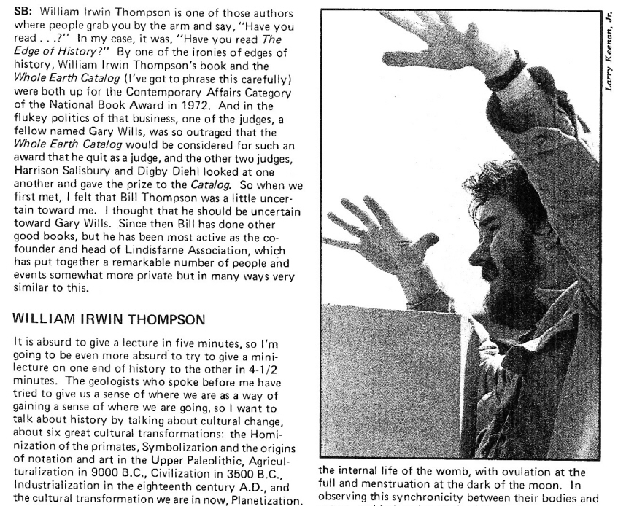
CQ 20
(Winter
1978)

Slide 33
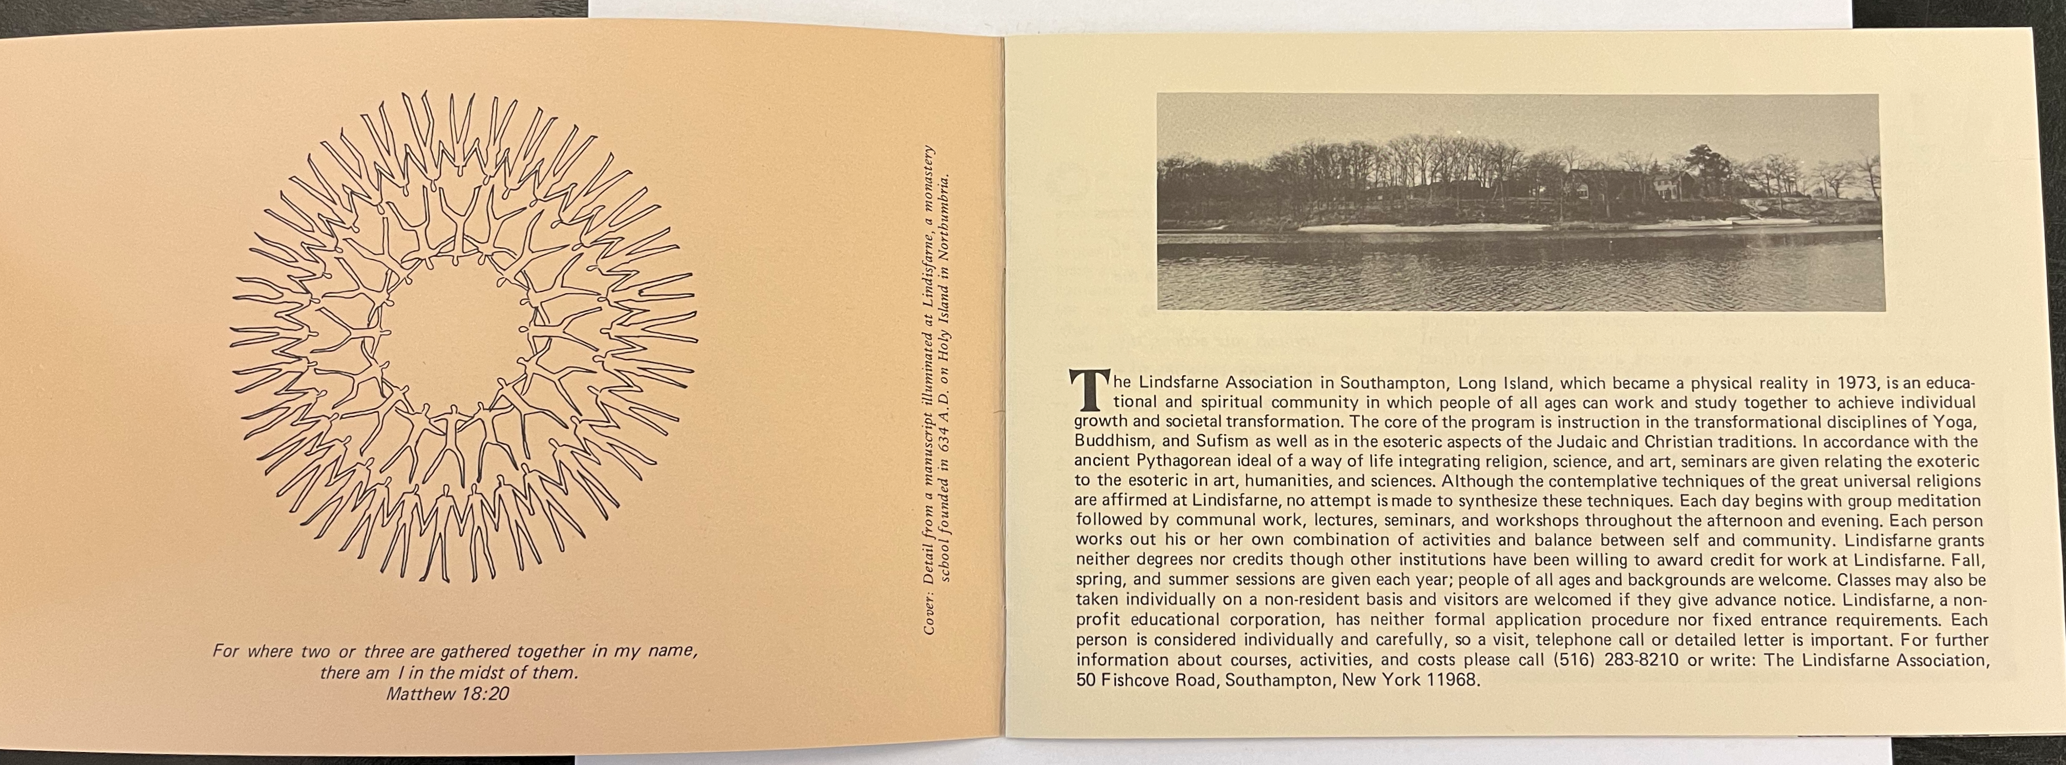
1974 brochure for Lindisfarne’s original incarnation as an intentional community on Long Island, NY
—Gregory Bateson papers, University of California/Santa Cruz

Slide 35
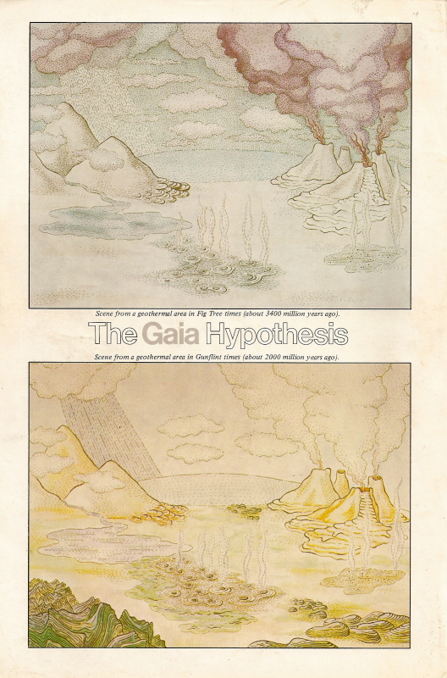
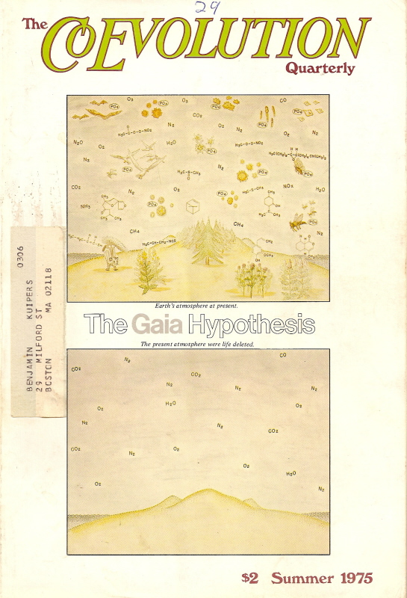

Slide 36
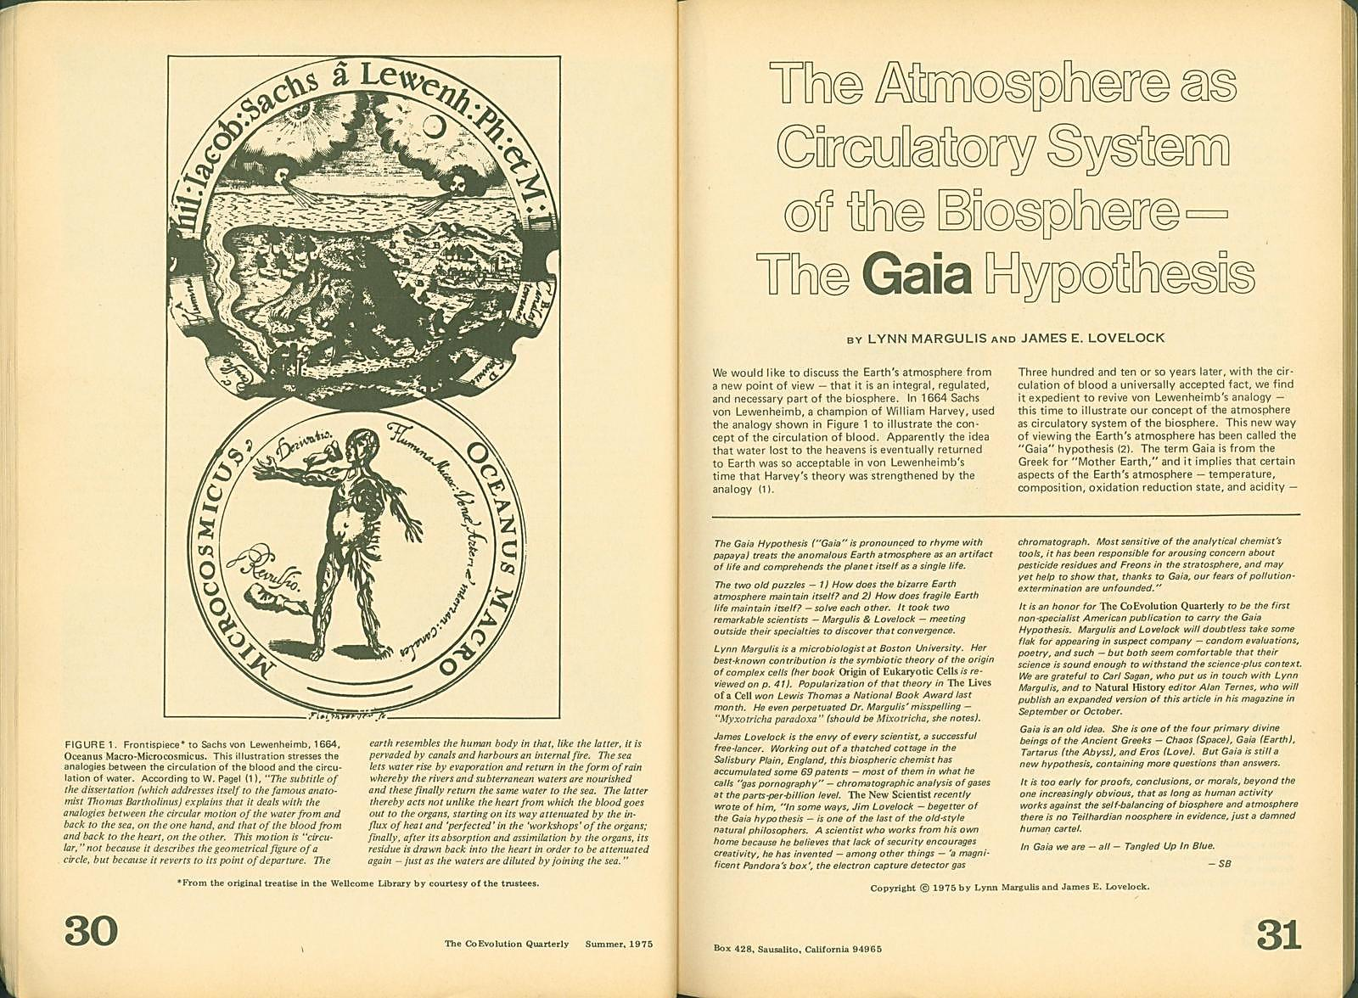

Slide 37
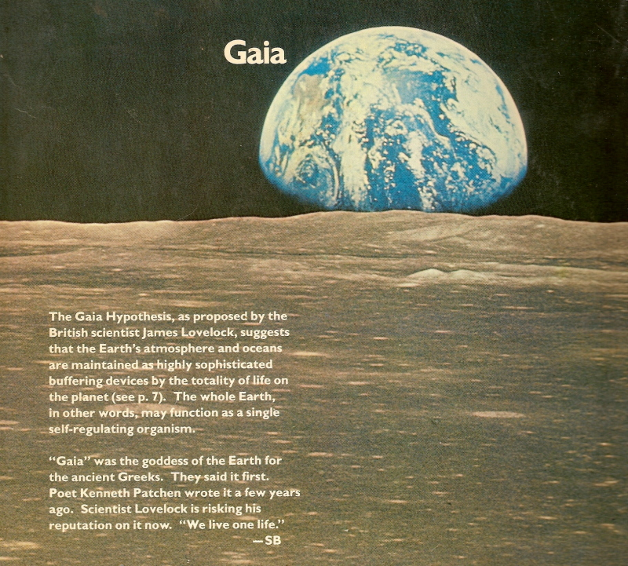
Taken “July 1969, during Apollo 11, the original Moon landing mission. Nowhere in the solar system is the contrast between a living and a dead planet so conspicuous as on the Moon at Earthrise. —SB”
(NWEC, 1).
Next Whole Earth Catalog (October 1980), outside back cover (detail)

Slide 38
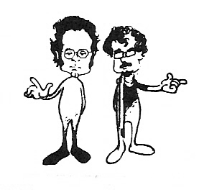
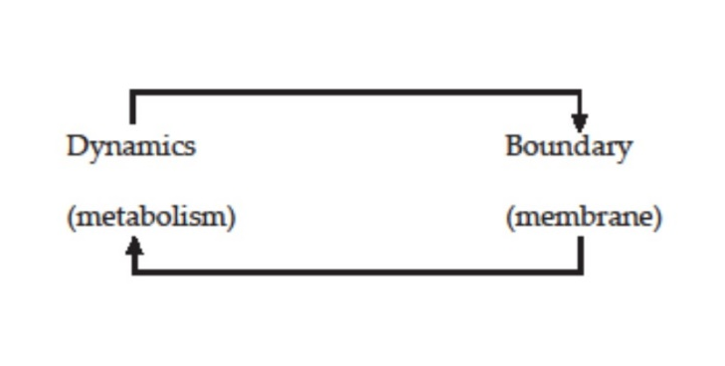
Francisco Varela
Autopoiesis of the cell, from Maturana and Varela, The Tree of Knowledge, 1992

Slide 39
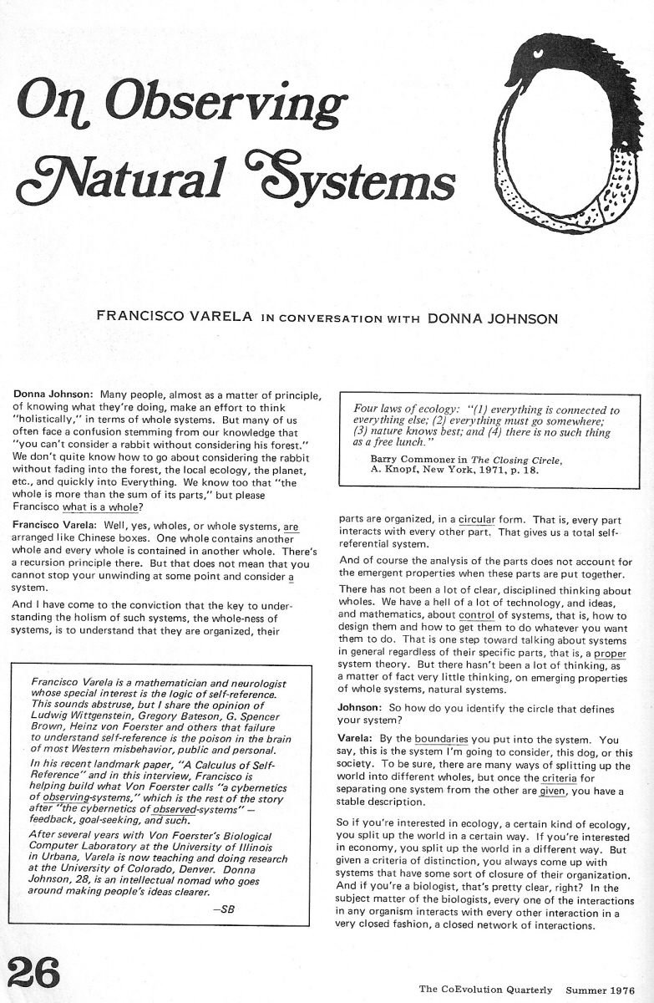
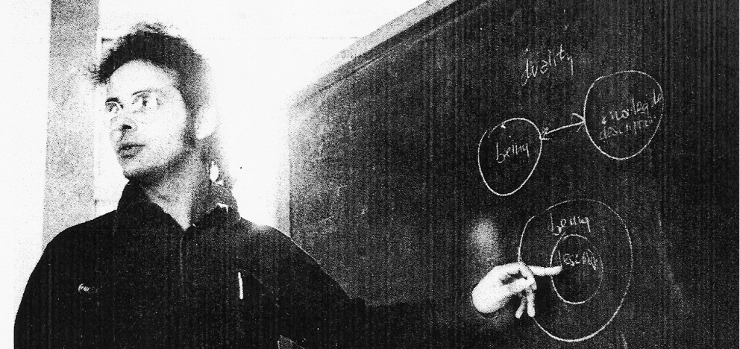
CQ 10 (Summer 1976)
Francisco Varela, “Not One, Not Two:
Position Paper for the Mind-Body Conference,” CQ 11 (Fall 1976)

Slide 40
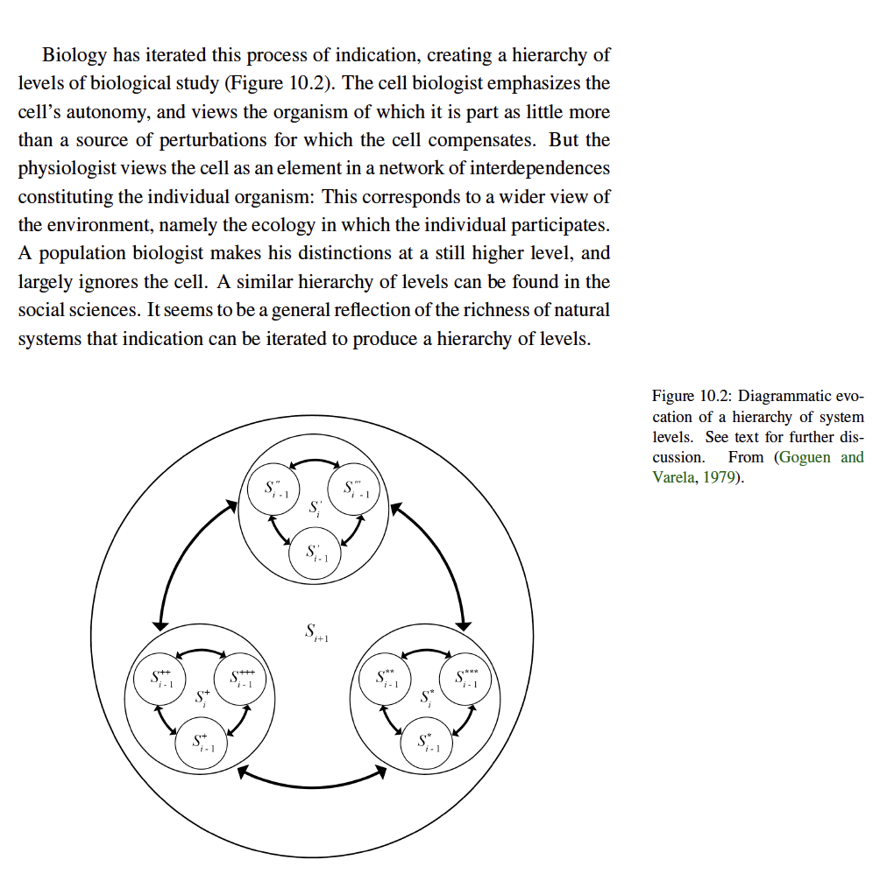
—In the thick of Varela’s Principles of Biological Autonomy

Slide 41
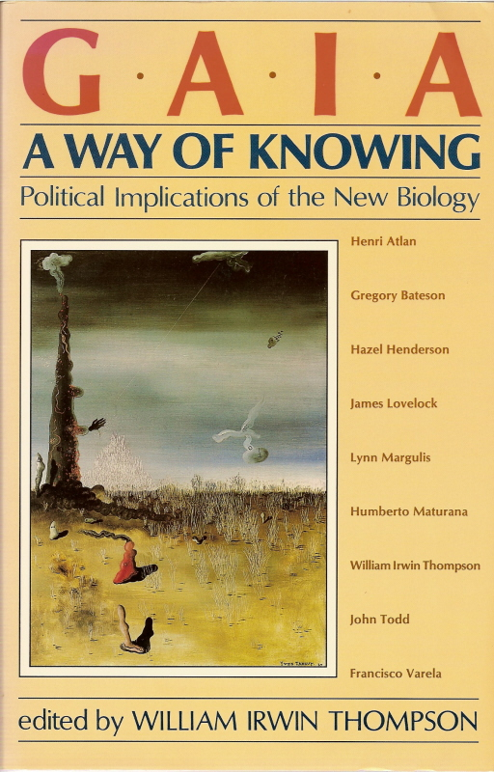
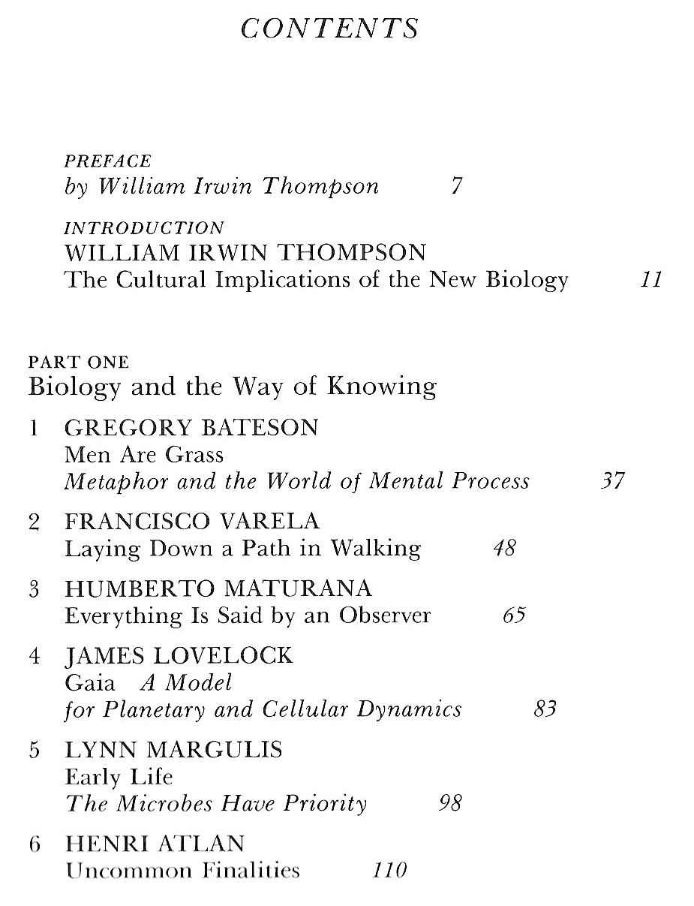
Gaia: A Way of Knowing (conference in 1981; published in 1987)

